Slide 1


SQuAD: 100,000+ Questions for Machine Comprehension of Text
Rajpurkar et. al.
Presented By:
Manash
Co-founder, engali.AI
Research Assistant - Data Science

Slide 2
Lessons to learn from this paper
How to build dataset for a unique problem
Create baseline models
Analyze a dataset based on specific metrics (create one when none is available)

Slide 3
Abstract
Stanford Question Answering Dataset (SQuAD) is a reading comprehension dataset
A strong multinomial logistic regression model was built which achieved an F1 score of 51.0%
Where human performance is 86.8%
The main challenge is to build such dataset and see how machine performs on this abstract level problem.

Slide 4
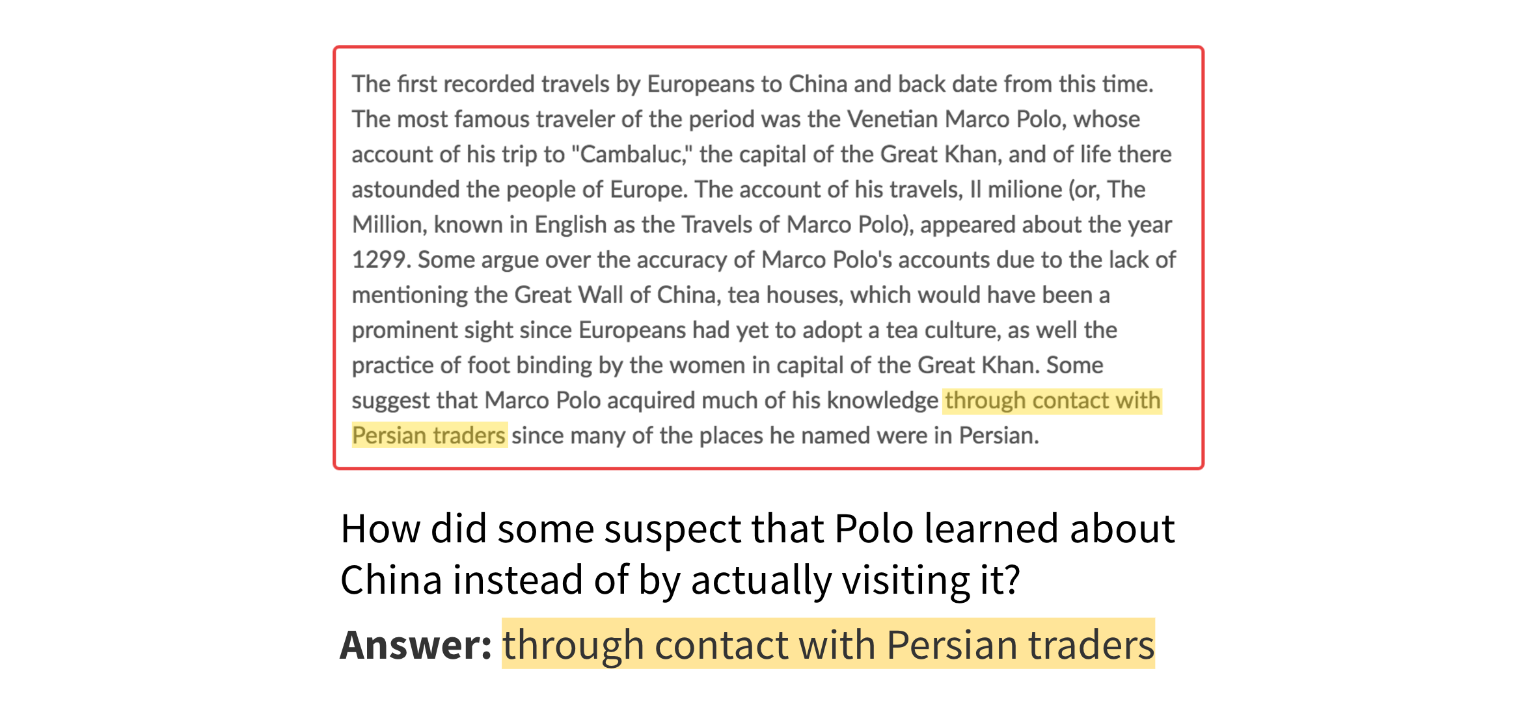
Example

Slide 5
Properties of the dataset
It does not provide a list of answer choices for each question.
System must select the answer from all possible spans in the passage.
Rich diversity of answer types in SQuAD
Automatic techniques to quantify diversity

Slide 6
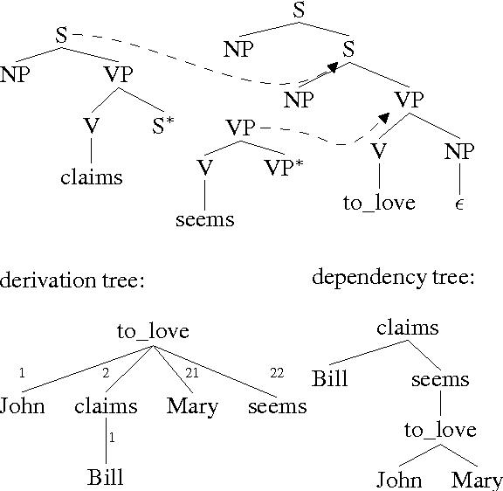
Assessment of Difficulty : Which Method Worked
A logistic regression model was built with a range of features.
Lexicalized and dependency tree path feature

Slide 7
Assessment of Difficulty : Which Method Didn’t Work
Model performance worsens with increasing complexity of
Answer types
2. Syntactic divergence between the question and the sentence containing the answer; but there is no degradation for humans.

Slide 8
Existing Datasets
Reading comprehension
Open-domain Question Answering
Cloze datasets
Answers are single word based
NLP Dataset Collection

Slide 9
Dataset Collection
Three stages of dataset collection:
Curating passages
Crowdsourcing question-answers on those passages
Obtaining additional answers

Slide 10
Dataset Analysis
Diversity in Answers
Separating numerical and non numerical answers
Non numericals are categorized using POS tags generated by Stanford CoreNLP
Reasoning required to answer questions
Labeling total dataset into following categories
Lexical variation (synonymy) - Question and answer sentences synonymous
Lexical variation (word knowledge) - Require word knowledge to resolve connection
Syntactic variation - Paraphrased form of a question doesn’t match with the answer
Multiple sentence reasoning - Higher level fusion of multi sentence
Ambiguous

Slide 11
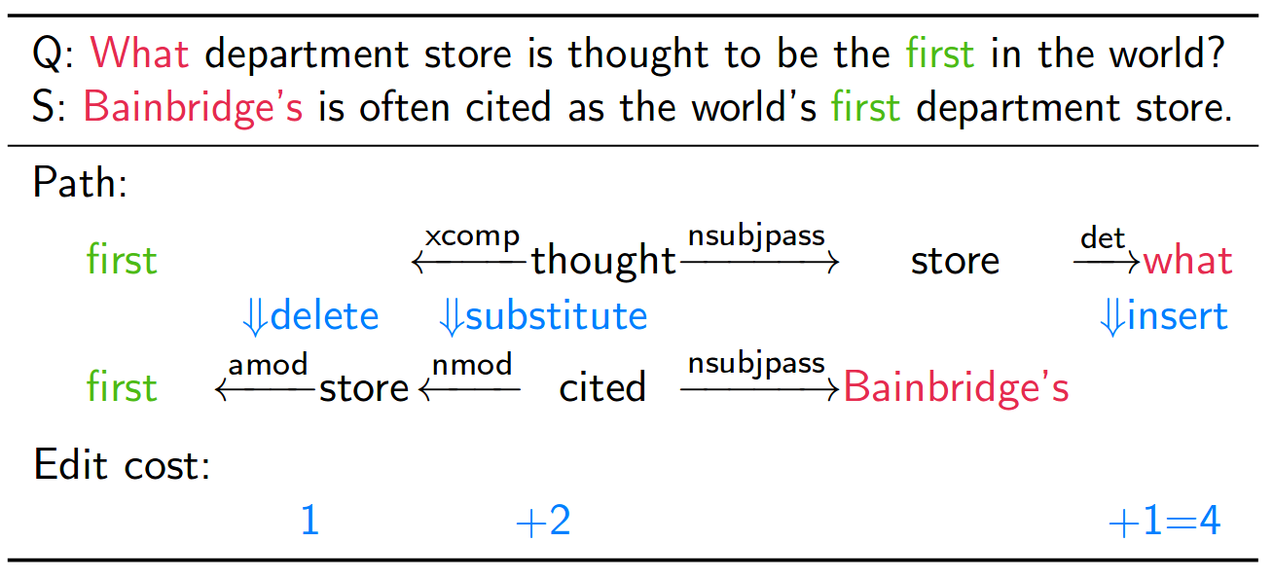
Dataset Analysis (contd.)
3. Stratification by syntactic divergence
An automatic method to quantify the syntactic divergence

Slide 12
Methods to Solve
Candidate Answer Generation
Assuming there are M tokens in a passage, there are O(M^2) possible answers to each question.
Stanford CoreNLP was use to prune large possible answers.
Sliding Window Baseline
For each candidate answer, all candidates that have maximum overlap were kept. Then answers were chosen using sliding window based method.

Slide 13
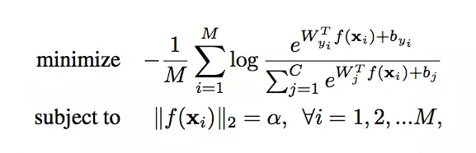
Methods to Solve (contd.) : Logistic Regression
Logistic Regression
In this model, several features from each candidate answer were extracted.
Model Details
Loss: Multiclass log-likelihood
Optimizer: Adam (Learning Rate = 0.1)
Regularization: L2
Regularization Strength: 0.1 / number of batches

Slide 14
Methods to Solve (contd.) : Features for LR Model
Matching Word Frequencies (Unigram & Bigram)
Sum of TF-IDF of the words that occur in both the question and the sentence containing the candidate answer.
Root Match
Matching the root of parsing dependencies from answer and question sentence.
Lengths
Number of words to the left, right, inside span and in the whole sentence.

Slide 15
Methods to Solve (contd.) : Features for LR Model
Span Word Frequencies
Sum of the TF-IDF of the words in the span of question, regardless of their position.
Constituent Label
Parse tree label of the span, optionally combined with the wh-word in the question.
Span POS Tags
Sequence of the POS tags in the span.

Slide 16
Methods to Solve (contd.) : Features for LR Model
Lexicalized
Lemmas of question words combined with the lemmas of words within distance 2 to the span in the sentence based on the dependency parse trees.
Dependency Tree Paths
For each word occurs in both the Q&A, the path in the dependency parse tree from the word in the sentence to the span.

Slide 17
Model Evaluation
Exact Match
(Macro-averaged) F1 Score
Loosely measures the average overlap between the prediction and ground truth answer.
Prediction and ground truth are considered as bags of tokens, then compute their F1.
Maximum F1 over all of the ground truth answers are taken for a given question, then average the score over all questions.

Slide 18
Human Performance
Exact Match Metric:
77% On Test Set
F1 Metric:
86.8% on Test Set

Slide 19
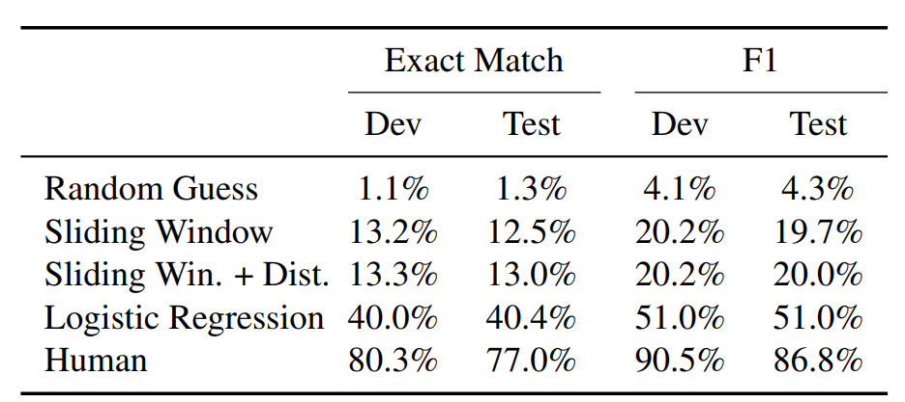
Performance Comparison

Slide 20
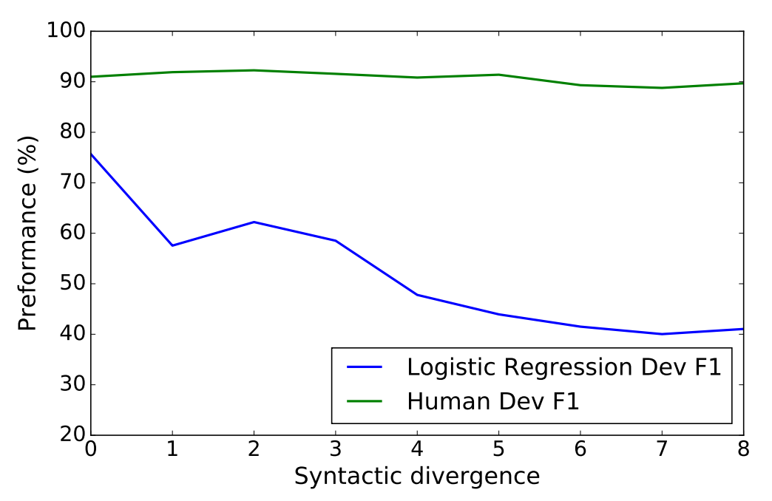
Effect of Syntactic Divergence

Slide 21
Conclusion
Main goal is to view datasets as a way to guide progress towards the end goal of NLU.
Based on some unique features of this dataset it differs from the most of the traditional RC and Q&A datasets.
A Logistic Regression model was proposed along with the dataset as a baseline model.

Slide 22
Thank you all

